Slide 1
Exploring student engagement with academic staff
Workshop Six
The students’ association.
Editable slide pack.

Slide 2
1. Understanding students’ associations

Slide 3
What is a students’ association?
Membership body consisting of all students at an institution (unless they opt out).
Defined by various legislation.
Funded by its institution.
Represents students on key committees that shape the learning experience.
The institution’s governing body has various oversights, such as approval of accounts, assurance of democratic elections.

Slide 4
Key aspects of SAs
Most SAs in Scotland affiliate to NUS.
SAs are engaged by sector agencies in national policy and decision-making.
SFC funds Developing College Students’ Associations project for college sector: managed by NUS Charity and sparqs.
This project created a useful framework…

Slide 5
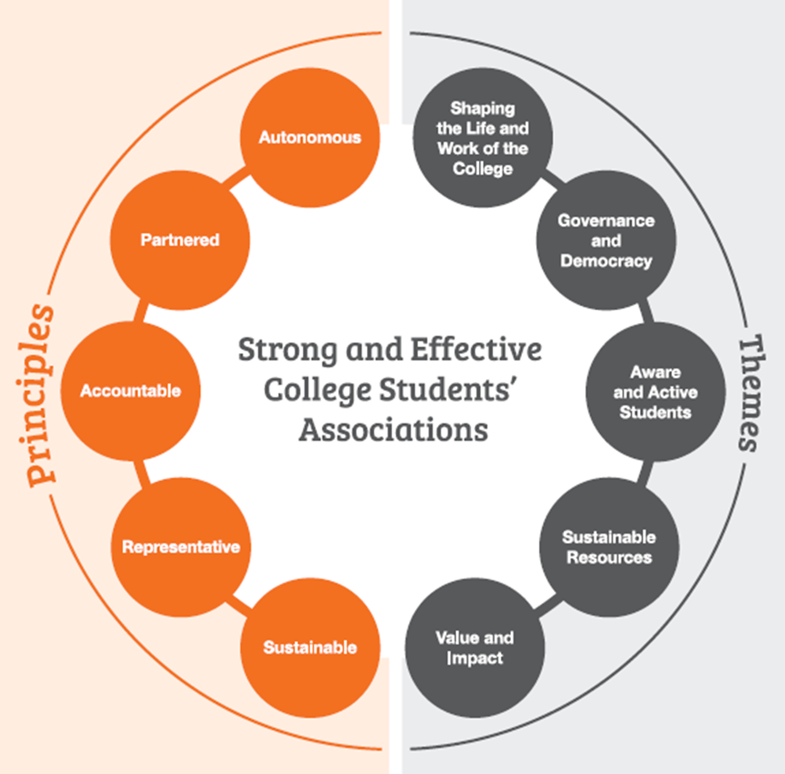
Framework for the Development of Strong and Effective College Students’ Associations

Slide 6
Partnership with students’ associations
Patronised | Partnered
Peripheral | Pioneered
Institution’s involvement
Institution’s support
See the sparqs website for more.

Slide 7
2: Working with your students’ association

Slide 8
Key SA contacts
Director | President
Representation coordinator | Education officer

Slide 9
National engagement

Slide 10
Institutional engagement
Key committees and forums.
Institutional strategies: including on partnership.
Student-Led Teaching Awards.
Reviews.
Campaigns on learning and teaching.

Slide 11
Academic reps

